Slide 1

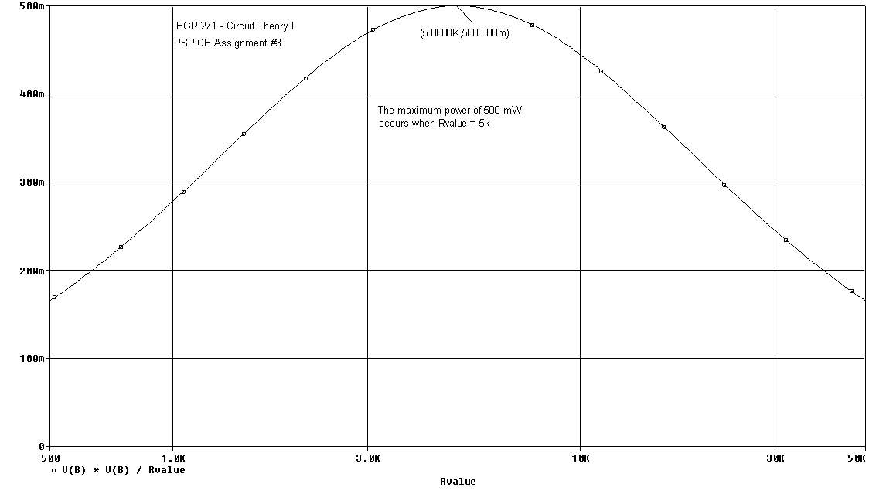
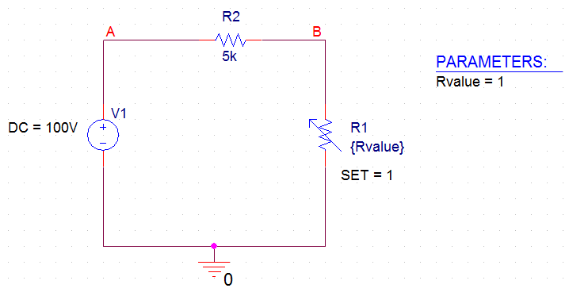
PSPICE Lecture #3
1
PSPICE Lecture #3
Reference: (see course web site)
Sample PSPICE Report
PSPICE Example: Max Power Transfer - Varying a Resistor
PSPICE Assignment #3
Topics to be presented:
Varying components in PSPICE
Maximum Power Transfer Theorem

Slide 2
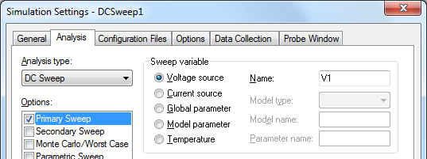
PSPICE Lecture #3
2
DC Sweep
A DC Sweep analysis in PSPICE can be used to vary a:
Voltage source
Current Source
Global parameter (such as a resistor, inductor, or capacitor)
Model parameter (such as a constant in a PSPICE model)
Temperature
Covered in PSPICE Lecture #2
Covered here in PSPICE Lecture #3
Quantities that can be varied using a DC Sweep

Slide 3
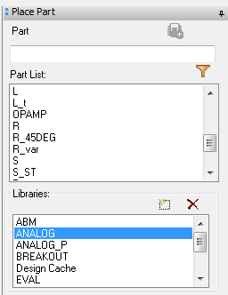
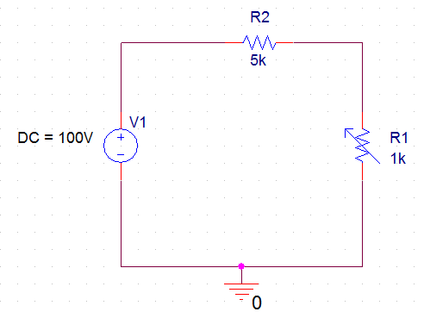
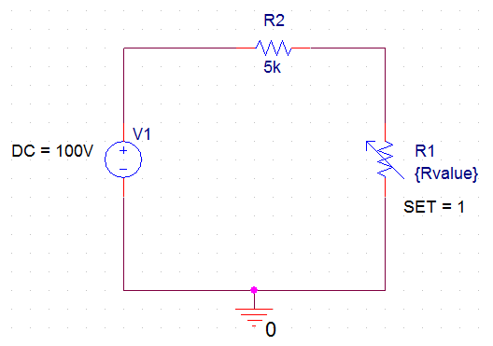
PSPICE Lecture #3
3
Varying a component (Global Parameter) in PSPICE
Follow these steps to vary a component in PSPICE:
Draw the schematic using a variable part for the component to be varied. For example, use part R_var, not R. Similarly, use part C_var to vary a capacitor.
Change the value of the part to a name in braces. For example, change 1k to {Rvalue}.
Change SET. Double-click on the part and change the property named SET from 0.5 to 1. Also display this property. The value of R is actually multiplied by SET, so using SET = 0.5 is confusing.

Slide 4
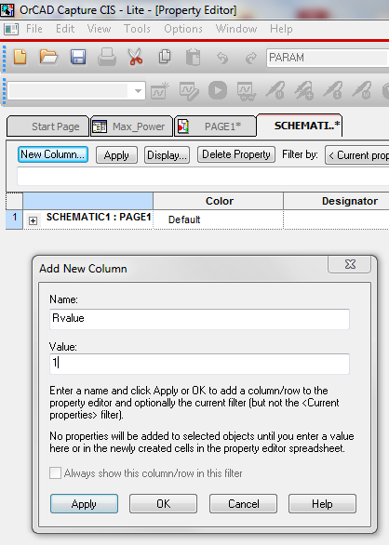
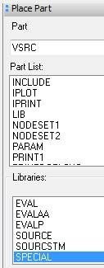
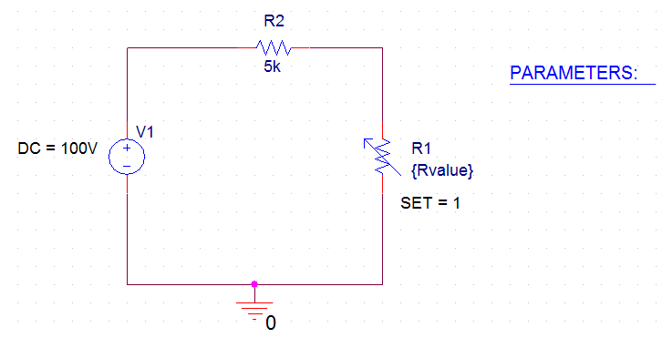
PSPICE Lecture #3
4
Varying a component (Global Parameter) in PSPICE (continued)
Add a part named PARAM. Place the part (it will appear as PARAMETERS) on the schematic next to the circuit. PARAM is located in the SPECIAL library.
Add a property (column) to PARAM.
Double-click on PARAMETERS to open the Property Editor.
Select New Column to add a new property to PARAM.
Name the New Column Rvalue (the name usesd for the variable resistor.
Give the New Column a Value of 1 (any value).

Slide 5
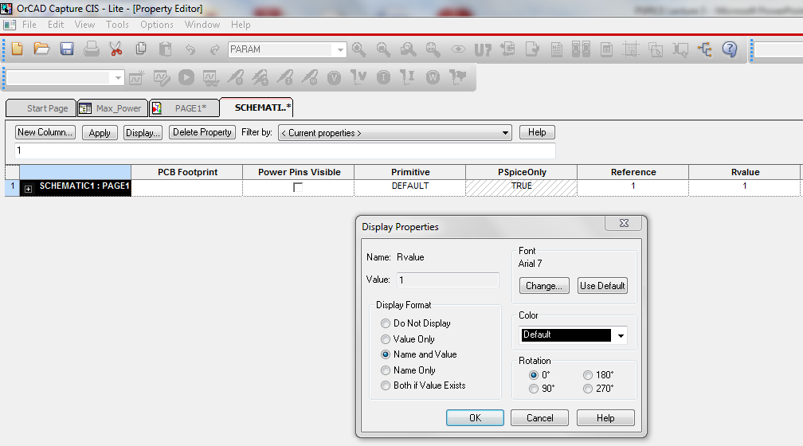
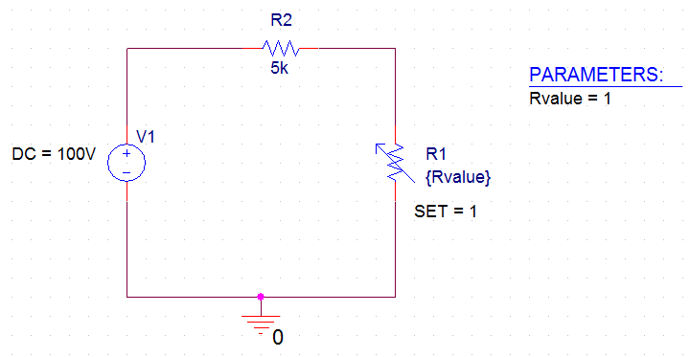
PSPICE Lecture #3
5
Varying a component (Global Parameter) in PSPICE (continued)
Display the new property. The new property just added will not be shown by default. In general, always display and new values added or any values that are altered in PSPICE. To display the property:
Double-click on PARAMETERS to open the Property Editor.
Scroll through the properties to find and select the new property added (Rvalue).
Select Display to open the Display Properties window. Select Name and Value.
Close the Display Properties window and note the change to the schematic.

Slide 6
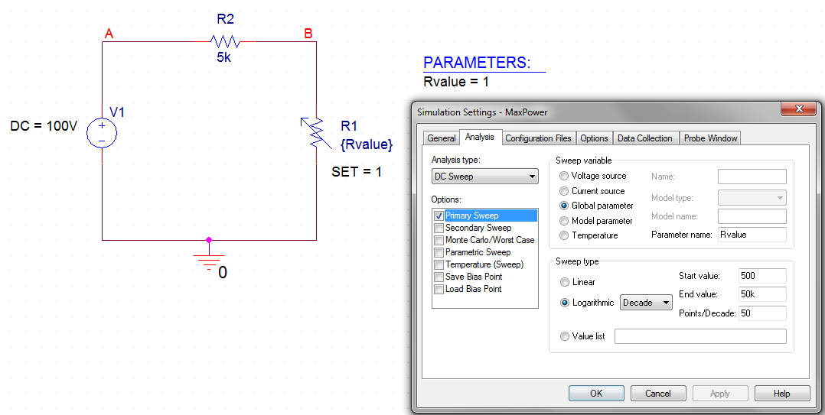
PSPICE Lecture #3
6
Varying a component (Global Parameter) in PSPICE (continued)
Create a Simulation Profile.
Select PSPICE – New Simulation Profile
Change the Analysis type to DC Sweep
Select Global parameter
Select Logarithmic for this example and vary Rvalue from 500 to 50k.
Using 50 points/Decade will result in a total of 100 points in this example.
Select OK.
Note that nodes A and B were labeled on the schematic. This will make it easier to refer to the output voltage, V(B), later.

Slide 7
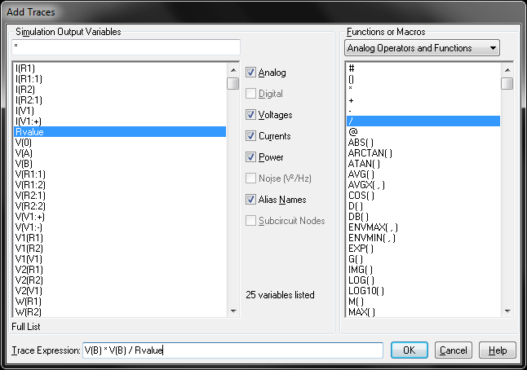
PSPICE Lecture #3
7
Varying a component (Global Parameter) in PSPICE (continued)
Analyze the circuit. Select PSPICE – Run
Graph Power vs Resistance for R1
Select Add Traces and enter the expression for the power to resistor R1: V(B)*V(B)/Rvalue

Slide 8
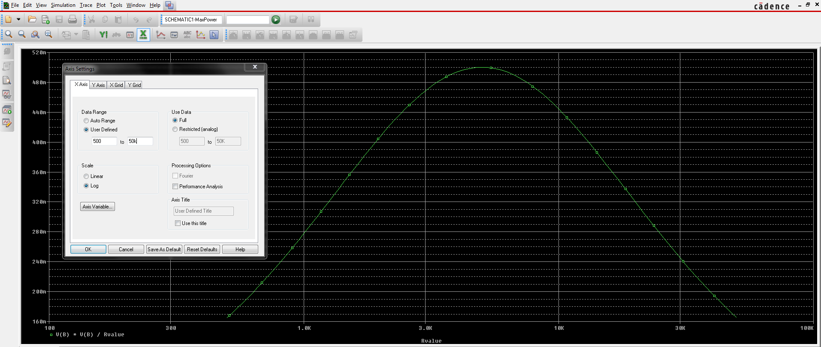
PSPICE Lecture #3
8
Varying a component (Global Parameter) in PSPICE (continued)
Graph Power vs Resistance for R1
Select Add Traces (or use toolbar) and enter the expression for the power to resistor R1: V(B)*V(B)/Rvalue
Select Plot – X-axis and change the range to 500 to 50k
Select Plot – Y axis and change the range to 0 to 500m.

Slide 9
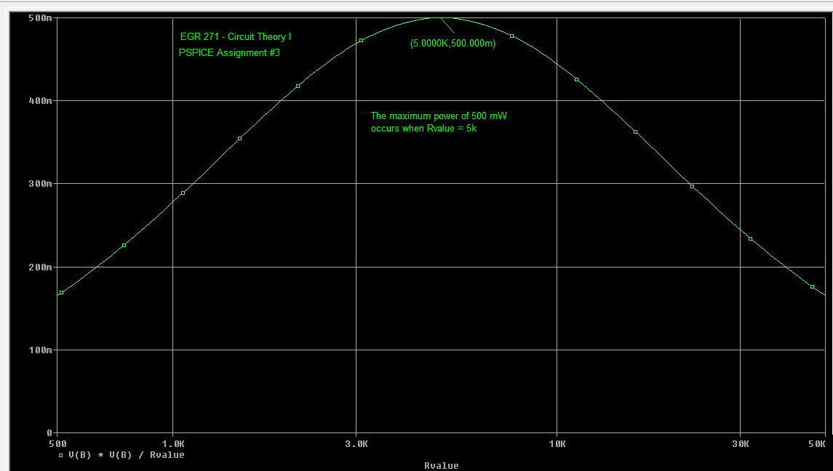
PSPICE Lecture #3
9
Varying a component (Global Parameter) in PSPICE (continued)
Graph Power vs Resistance for R1
Select Trace – Cursor – Display (or use toolbar) to turn on the cursor
Select Trace – Cursor – Peak (or use toolbar) to move the cursor to the peak
Select Plot – Label – Mark (or use toolbar) to mark the point
Select Plot – Label – Text (or use toolbar) to add text to the graph

Slide 10
PSPICE Lecture #3
10
Varying a component (Global Parameter) in PSPICE (continued)
Graph Power vs Resistance for R1
Select Window – Copy to Clipboard to copy the graph (with a white background) to the clipboard where you can paste it into Word or elsewhere.

Slide 11
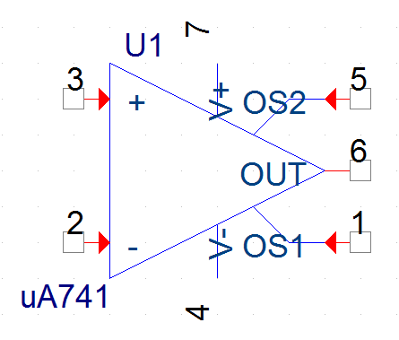
PSPICE Lecture #3
11
Operational Amplifiers
Operational amplifiers can be analyzed in PSPICE using different models, including:
Using specific part from the EVAL library, such as the uA741
Use a general op amp circuit model consisting of a dependent source and a resistor
Typical values for the op amp model shown:
A_{OL} = 100,000
R = 2MΩ - 10MΩ

Slide 12
PSPICE Lecture #3
12
Example
Analyze the following op amp circuit (find V_{o} and I_{o}):
By hand
Using PSPICE with the uA741 op amp
Using PSPICE with a general op amp model (dependent source and resistor)
30k
_
10k
V_{o}
+
-
+
I_{o}
6V
9k
Hand Analysis:

Slide 13
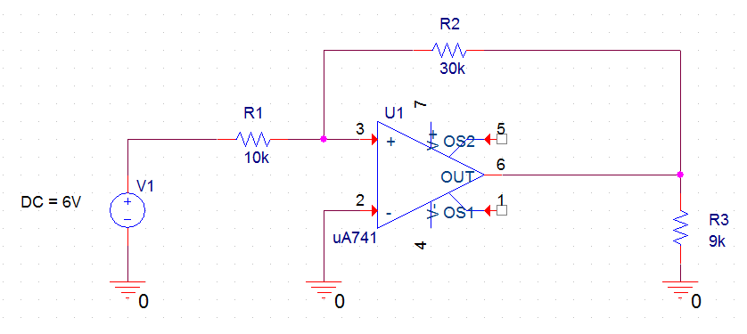
PSPICE Lecture #3
13
PSPICE analysis with the uA741 op amp:
Draw the schematic. Use the uA741 from the EVAL library.
Ignore the connections labeled OS1 and OS2. In practical lab situations, an adjustable resistor (potentiometer) can be connected between these terminals to “zero” the op amp (to set the output to 0V when the input is 0V). This is somewhat like zeroing your bathroom scale.

Slide 14
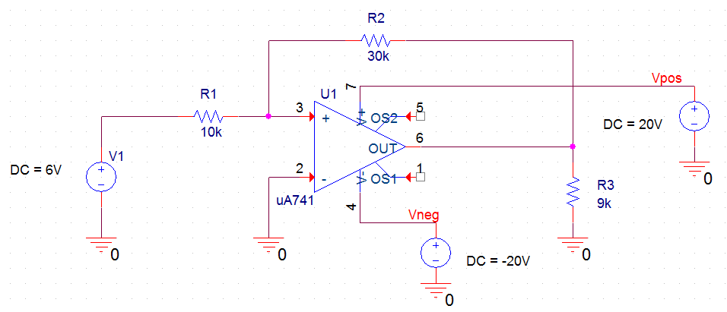
PSPICE Lecture #3
14
Add voltage sources to power the op amp. The value of the voltage sources depends on Vo. In general, the source voltages should be greater than V_{o}. In practical situations, it is recommended that they be greater by at least 2V. Since V_{o} = -18V, supply voltages of +20V and -20V have been added below.

Slide 15
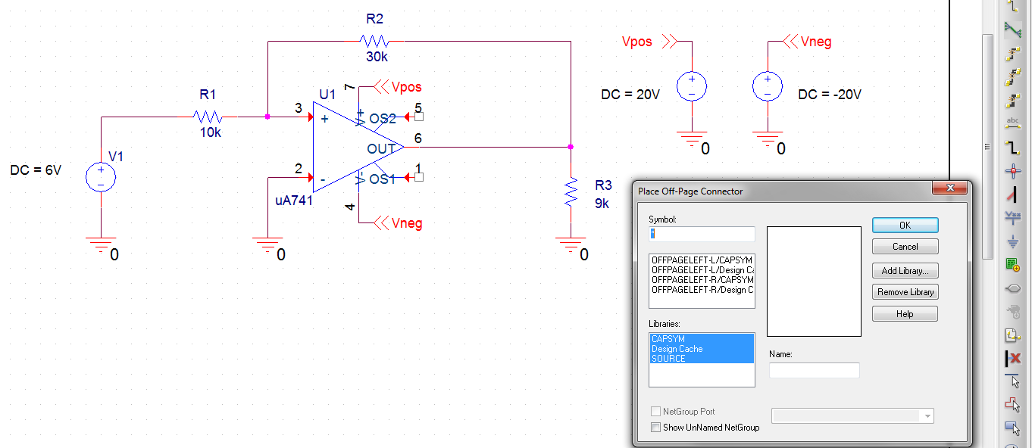
PSPICE Lecture #3
15
Note: To avoid crowding, the supply voltages can be placed to the side and connected to the circuit using OFFPAGE Connectors. Note the name of the OFFPAGE connector also serves as a node label.

Slide 16
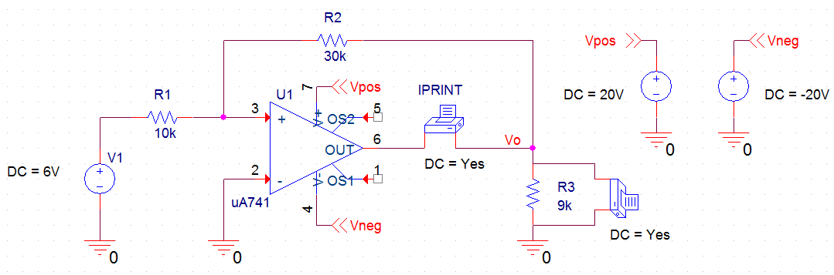
PSPICE Lecture #3
16
Add voltage and current printers to measure Io and Vo.
Be sure to change the DC property on each printer to Yes and display the property.
Be sure to place the current printer in series and place the voltage printer in parallel.
It is also a good idea to label the node for the output voltage as Vo.

Slide 17
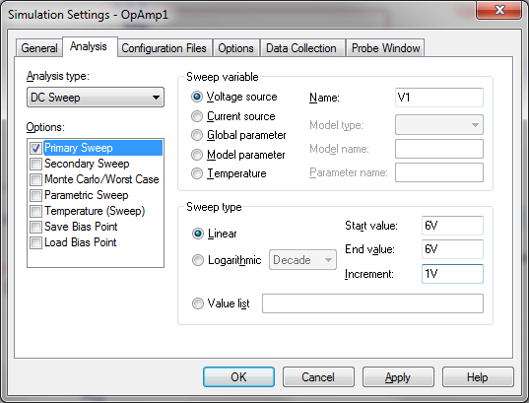
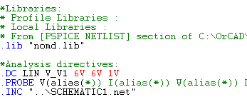


PSPICE Lecture #3
17
Create a New Simulation Profile, Run PSPICE, and view the results in the OUTPUT file.
A portion of the .OUT file
Note that the results match the hand analysis:
V_{o} = -18V and I_{o} = -2.6 mA

Slide 18
PSPICE Lecture #3
18
PSPICE analysis using a model consisting of a dependent source and a resistor:
Draw the schematic. Use R_{in} = 2MΩ and A_{OL} = 100,000
Substitute op amp model
In place of op amp in circuit
30k
_
10k
V_{o}
+
-
+
I_{o}
6V
9k

Slide 19
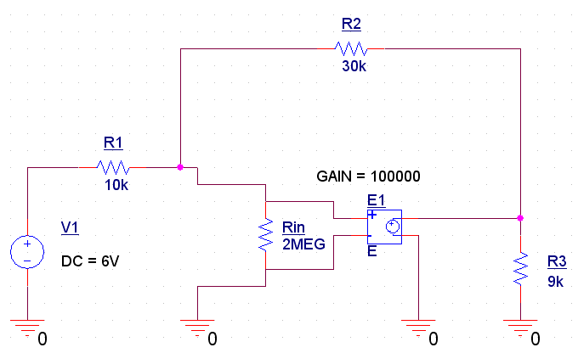
PSPICE Lecture #3
19
Draw the schematic (continued).
Use R_{in} = 2MΩ and A_{OL} = 100,000 (exact values are not critical)
Dotted lines not part of schematic.
Added for emphasis.

Slide 20
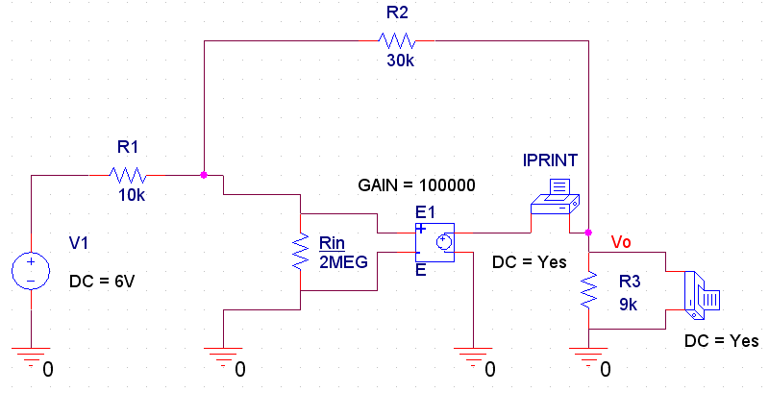
PSPICE Lecture #3
20
Add voltage and current printers to measure Io and Vo.
Be sure to change the DC property on each printer to Yes and display the property.
Be sure to place the current printer in series and place the voltage printer in parallel.
It is also a good idea to label the node for the output voltage as Vo.

Slide 21
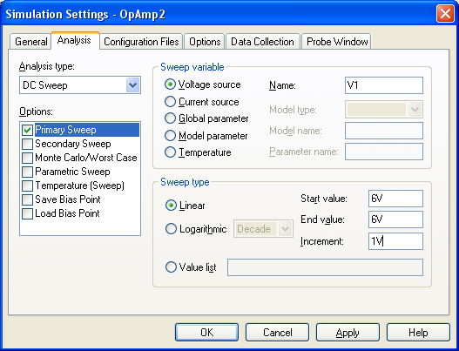
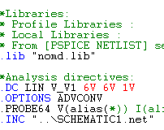
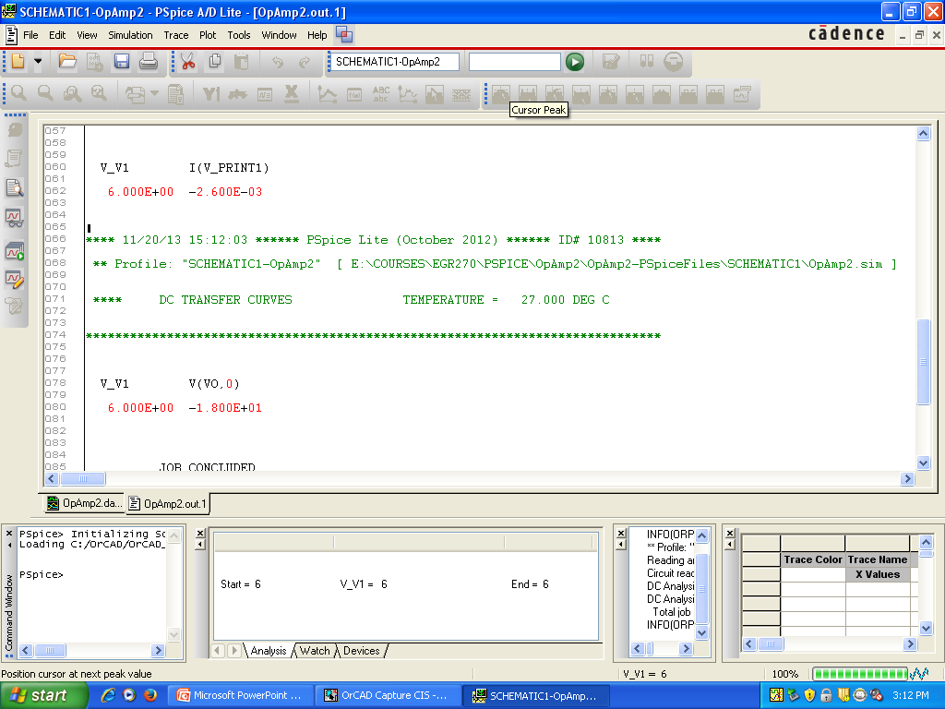
PSPICE Lecture #3
21
Create a New Simulation Profile, Run PSPICE, and view the results in the OUTPUT file.
Note that the results match the hand analysis:
V_{o} = -18V and I_{o} = -2.6 mA

